Slide 1

Colin Michael DSC 680: Project 2 May 4th, 2024 School attendance by Student Groups

Slide 2
Public Education in the U.S.
Public education is a basic right of all people living in America
It is crucial that young people are afforded the opportunity to gain an education and better themselves
Students need to attend school to get the maximum value from the educational system.
It is a topic that I am personally very passionate about. Education has helped me out tremendously, and I want to see other people have similar opportunities.

Slide 3
Research Plan
My second project in DSC 680 will be focused on school attendance rate by students in Connecticut public schools’ grades PK-12 for the 2020-2021 and 2021-2022 school years
I will be assuming the role of a data scientist hired by the State of Connecticut
My primary goal is to utilize the existing data on school attendance to provide recommendations to Connecticut on how to improve school attendance
Data set gathered from Kaggle.com

Slide 4
Data Explanation
CSV data set, including 2,000 rows of data, with each row of data providing enrollment and attendance numbers for different segments of students across all the school districts in Connecticut.
Each row falls into a category of homelessness, students with disabilities, free/reduced lunch, English learners, race/ethnicity, and high need
I will be using these factors as independent variables, with attendance as the dependent variable.
I want my findings to be actionable for the State of Connecticut to guide public policy.

Slide 5
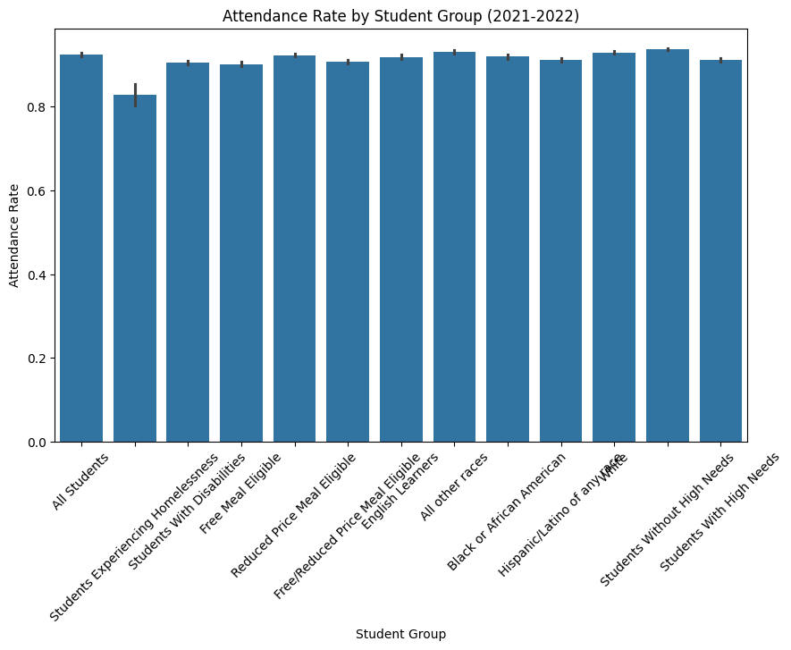
Data Visualizations

Slide 6
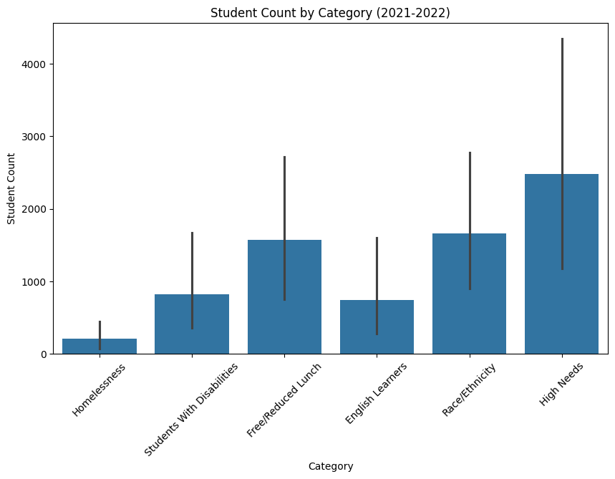
Data Visualizations

Slide 7
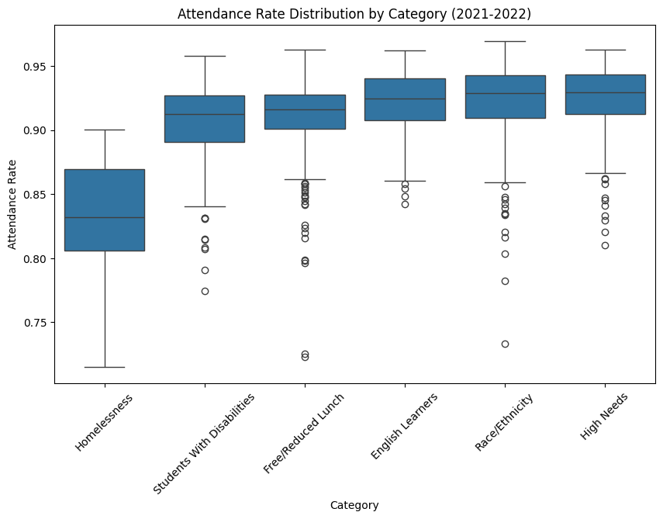
Data Visualizations

Slide 8
Regression Analysis
I performed an Ordinary Least Square regression on my dataset in Python.
I used 2021-2022 attendance rate as my dependent variable because that is what I am trying to evaluate.
My independent variables were 2020-2021 student count, 2021-2022 student count, and all the student groups.
Categorical variables, so I had to convert them to dummy variables.

Slide 9
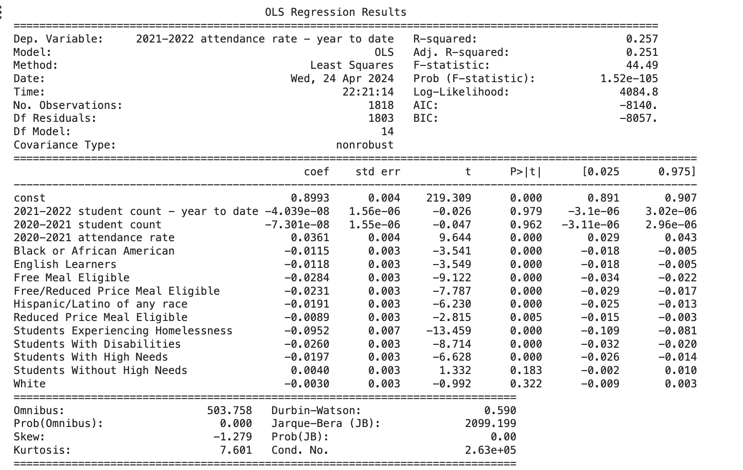
Regression Analysis

Slide 10
Regression Analysis
My model produced an R-squared of .257, which reflects that 25.7% of the variation in attendance rates are explained by the model.
The p-value is used to show statistical significance of the variables. We are ideally looking for a p-value under .05.
The following variables show a negative relationship towards 2021-2022 attendance with a significant p-value:
Black or African American, English Learners, Free Meal Eligible, Free/Reduced Priced Meal Eligible, Hispanic/Latino, Reduced Meal Price Eligible, Students Experiencing Homelessness, Students with Disabilities, White.
Students Experiencing Homelessness, Free Meal Eligible and Students with Disabilities had the highest negative relationship with attendance.

Slide 11
Recommendations and Future Applications
Based on my linear regression, I would advise the State of Connecticut to allocate additional resources to at-risk groups of the student population, with a focus on homelessness, disabilities, and free meal eligible groups.
I would like to evaluate if different regions of the United States have different variable impact on K-12 attendance
It would also be interesting to dive into specific age/grades of the dataset to see how different dependent variables impact different aged students.

Slide 12
10 Audience Questions
Why did you choose this project?
What surprised you the most about your findings?
What additional data point would you be interested in?
What is the biggest limitation of the paper?
What other States in the U.S. would you want to compare Connecticut to?
6. What are other data science methods you could apply to the project?
7. What is the single biggest takeaway from the study?
8. How would you improve the project to account for COVID-19?
9. Do you think private schools would have similar trends?
10. What is the impact on school size and attendance?

